Slide 1

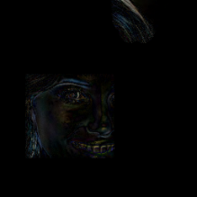






DDIM inversion
Mask
DIRE
DDIM Reconstruction

Slide 2



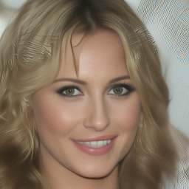
DDIM inversion
Input
DDIM Block
DCT
Block
DIRE
FreqUNet
(a) DCTDiffusion
(b) FreqUNet
Mask_Low
Freq_Low
Input
2D DCT
2D IDCT
Output
(c) DCT Block

